Slide 1
Big problems
Community solutions

Slide 2
Great plans
‘There needs to be a big change in the way communities, organisations and individuals work to support people. The Government has provided money specifically to help councils to make these changes. People want better quality services that are personal to them and more control over decisions that affect them. They want the right support, at the right time, in the right place’
Putting People First 2007

Slide 3
Big money!
‘To support this transformation the Social Care Reform Grant, worth £520 million...has been made available for councils to invest in the necessary system and process development’
Transforming Adult Social Care 2009

Slide 4
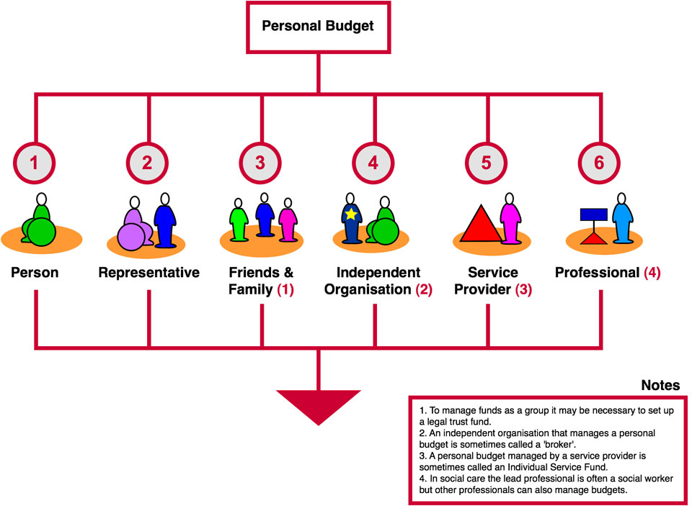
Options 1 to 6
In Control

Slide 5

Big change?

Slide 6
The reality 8 years on
‘More than 80 per cent of people surveyed said that a personal budget had made things better’
POET Survey Report 2014
BUT
‘Of all those who had personal budgets, 24% had a Direct Payment. Expenditure on “managed arrangements” represented around 47% of total spending on community based services: and expenditure on ISFs stood at less than 1% of total spending on community based services’
ADASS Personalisation Survey 2014
Notes:
SO self directed support makes a difference to people’s lives - quite a lot of people have got a personal budget BUT not very many of them are actually directing their own support. Story of a friend who didn’t know she had a personal budget

Slide 7

Real transformation hasn’t really happened in many places
Care and support doesn’t work well for a lot of people
Not much real choice
Public sector agencies are skint (and getting skinter)

Slide 8
The strategic challenges
Making personalisation real is a challenge
Markets are dominated by big, traditional care providers with little real choice available
  Commissioning and procurement practice which tries to use old systems and processes to get new things
  A focus on known ‘service models’
Government is committed to integrating health and social care but for progress to be made:
  services need to have a more person-centred approach
  investment in ‘low-level’ community support is needed

Slide 9
Strategic challenges
Top-down initiatives to engage communities ignore work already being carried out by local people rather than nurturing what’s there
People are only viewed as a bundle of (expensive) needs - their assets and talents are ignored
Risk, fear of blame, and lack of trust in people to make the right decisions ( often carefully concealed in a ‘safeguarding’ wrapper)
Changing everyone’s thinking (and doing)

Slide 10
An opportunity as well as a challenge?
Could austerity be the mother of invention?

Slide 11
‘If you do what you've always done, you'll get what you've always gotten’ Anthony Robbins
So to get something different we need to DO something different

Slide 12

What could be different?
Harnessing the power of people and communities – local people helping other local people

Slide 13
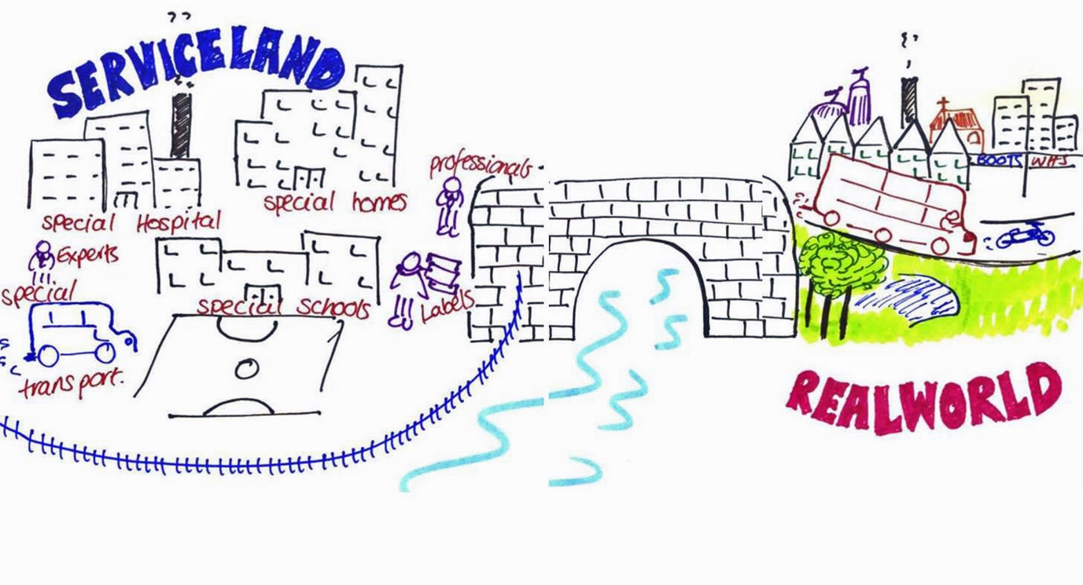
An opportunity to escape from serviceland (and serviceland thinking)
www.newpossibilities.co.uk

Slide 14
Enterprising Minds in Ayrshire
Change project run by charity Hansel and Community Catalysts in partnership with North Ayrshire Council
Supporting people with learning disabilities & those on the autistic spectrum to use their skills to:
  set up their own small business or non-trading enterprise and/or
  lead a community initiative
Harnessing the skills & good will of local people & businesses as member of supportive ‘enterprise circles’
Challenging limited views of people with a learning disability
Modelling different ways of thinking and doing
Big local profile & impact & strong outcomes for individuals

Slide 15
“People think that because I’ve got problems myself I’ve got nothing to offer!”

Slide 16
Hansel and Ashley’s Bow Wow Biccies
  Ashley has a passion for baking and a dog called Murphy
  Ashley linked with the Enterprising Minds (EM) project
  Ashley put her interests together to create Ashley’s Bow Wow Biccies – handmade biscuits for special pooches like Murphy
  Ashely was supported by EM to set up her enterprise, do market research, talk to local vets about recipes, register with Trading Standards
  Ashley sells her biscuits at local pet shops and grooming parlours

Slide 17
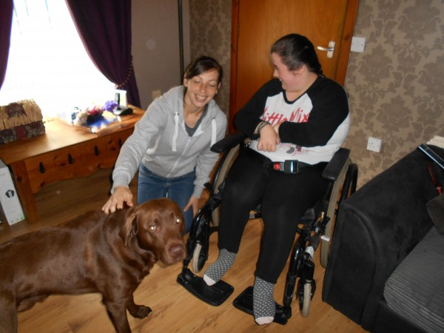
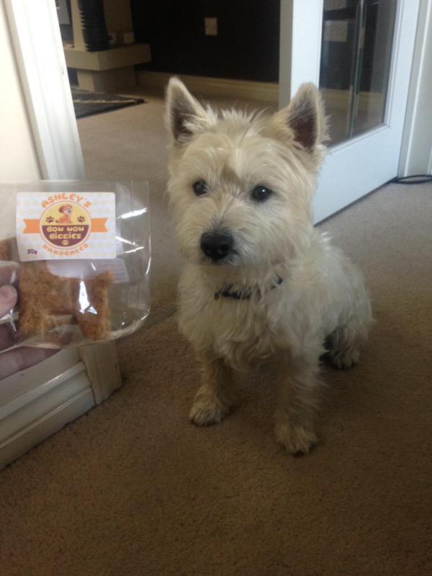

Slide 18
‘Ashley loves the sense of responsibility she gets from making and selling dog biscuits…She is very excited and keen to talk to people about it’
Maureen, Ashley’s Mum

Slide 19
What did Community Catalysts do?
Explored Hansel’s aspirations & co-designed the project
Facilitated an event aimed at people with a learning disability – explored assets & possibilities & engaged people
Helped Hansel to recruit and induct a project lead
Designed, tested & refined accessible tools and approaches to nurturing disabled entrepreneurs
Mentored project lead and provided ongoing specialist expertise to managers and local strategic leaders
Co-produced an engaging report on project outcomes
Facilitated ‘legacy planning’ to underpin future working, systems and culture change
Cost approx - £32,000 + VAT over 2 years

Slide 20
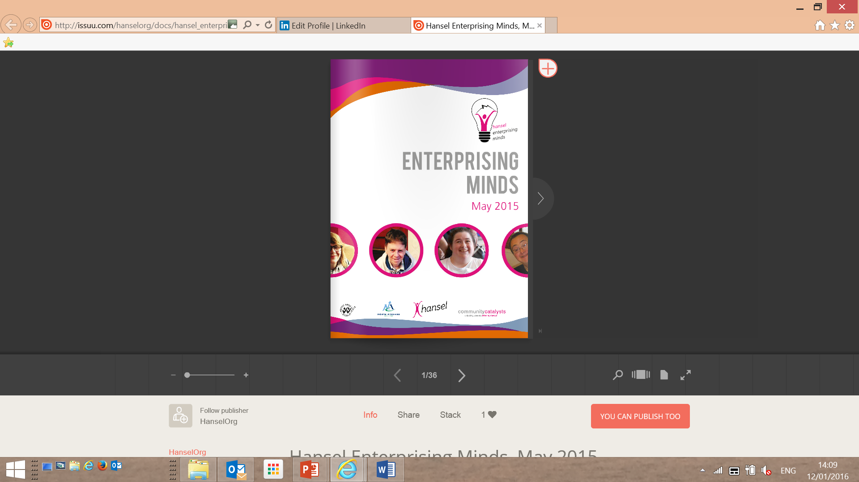

Slide 21
Nottinghamshire Community-enterprise Development Project
3 year partnership between Nottinghamshire County Council and Community Catalysts
Focus on gaps in rural areas and on hard-to-reach groups
Aims:
  to create choice for people with care and support needs
  to invest in community approaches and solutions which would link to the council’s ‘prevention’ agenda
  create systems and culture change within the council and wider

Slide 22
Pulp Friction CIC
  Supported from ‘start up’ by Community Catalysts
  Limited local options for young disabled school leavers
  Jessie has a learning disability - when she left school she wanted to work & didn’t want to go to a day centre
  Community Catalysts helped Jessie and her Mum set up Pulp Friction. Jessie is a Director of the social enterprise
  Work with young adults with learning disabilities to learn new skills and get work
  Started with cycle powered smoothie bar at community events, evolved to include a Glee Choir, Community Allotment & running the canteen for the local fire service!

Slide 23

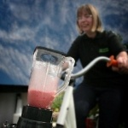
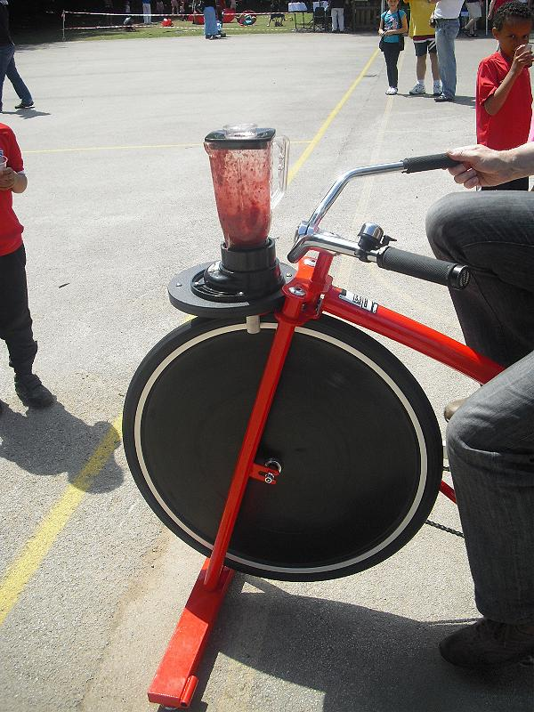
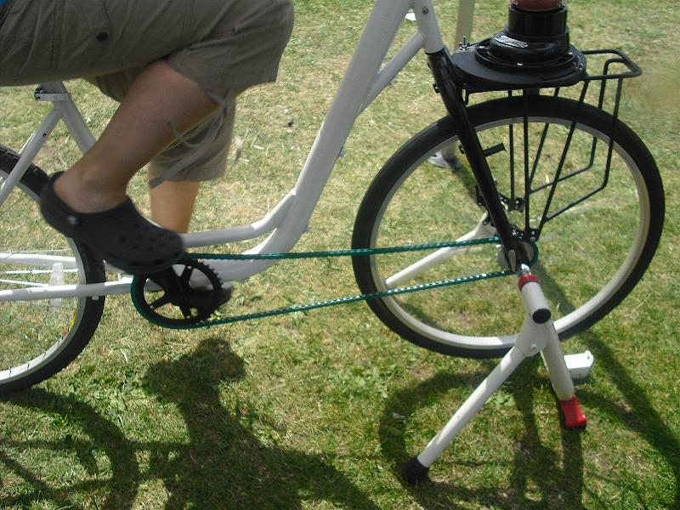

Slide 24
What did Community Catalysts do?
Scoped existing services, supports and community ‘care’ options
Employed a local catalyst who was integrated into the council commissioning team
Facilitated a successful strategic group to enable learning to translate into systems and culture change
Engaged 200+ people interested in setting up an enterprise with a care, health or wellbeing focus
Supported, mentored and advised 90+
Helped to create and sustain 64 new community ‘providers’ offering services and supports to 900+ older and disabled people
Cost - £22 - £32 pa plus catalysts’ salary and costs

Slide 25
Local
Community Catalyst
Access to guidance and policies
Marketing
Dealing with complaints
Advice on premises
Brokering interface with the Council
Signposting to experts
Shaping of enterprise idea
Help with tenders and contracts
Information on personalisation
Feedback on written work
Peer connections and networks
Help with finance and funding issues

Slide 26
Somerset Community Enterprise Project
Partnership between Community Catalysts and Somerset County Council
West Somerset has the oldest average age in the UK and is very rural.
Pressures of finding quality care and support to a growing number of people with decreasing resources
Self funders and people with Direct Payments also want something more and different
Project has a focus on community led development of home based care and support for older people - more variety, choice and capacity

Slide 27
Girl Friday
Pearl lives in the small coastal town of Watchet and runs the local florist shop
Had good local connections and was a point of contact for local people ‘the Garden Room has been a community meeting place since it opened, the kettle is always on for people in need of a chat’
Pearl has developed this into Girl Friday which matches local self-employed people and older people who need help at home
Rhys the Community Catalyst advises Pearl and the enterprising ‘home helps’, enabling them to establish systems and offer their safe and high quality services

Slide 28
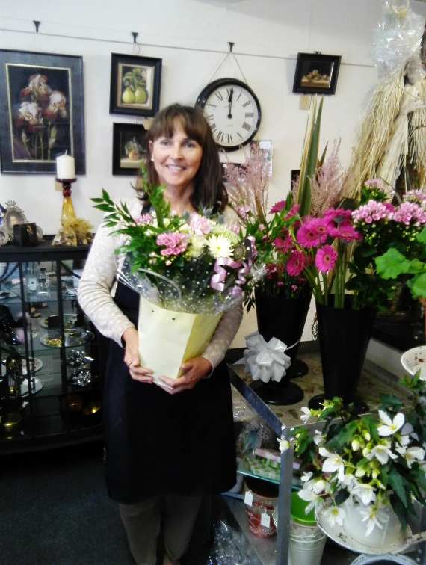

Slide 29
Quotes from community entrepreneurs
‘He has been really enthusiastic about my ideas, which has encouraged me to actually follow them through. He has given me loads of practical advice about setting up a business as a sole trader. He has also put me in touch with other similar micro providers for support and networking’
‘Rhys has opened many doors and liaised with individuals and networks that we were unable to access/unravel’
‘I give Rhys ten out of ten - he was instrumental in helping us achieve our vision’

Slide 30
Outcomes to date
In 12 months Community Catalysts has:
Supported the development of 42 new community enterprises & ventures. Each one offers older people help or care
Engaged other local supports that were ‘operating under the radar’ and helped them think about quality and sustainability
Supported the sustainability 68 community driven support options for older people in Somerset (46 of the 68 are offered in rural or isolated areas)
Seen an increase of 200 people taking a direct payment
Community enterprises supported by the project have created 65 jobs

Slide 31
“I like using what talents I have in a community sort of way”

Slide 32
Power of positive partnerships
Community Catalysts approaches linking with:
Local Area Coordination (LAC) - to ‘get alongside’ people who are marginalised & help them est. their own venture or gain imaginative support from community enterprises
Asset Based Community Development (ABCD) – to nurture community innovations that need/want to formalise
SPICE and time credits – to reward community activists and entrepreneurs and keep local resources local
Community Circles – extending person-centred planning for people with a talent or community enterprise idea

Slide 33
“…people…are not just passive recipients of social and health care, but have expertise, gifts, strengths that can help them achieve their vision for a good life, contribute to their local communities and maximise the impact of resources”
Bartnik 2008

Slide 34
Conclusions
Commission for outcomes to create the kind of ‘market’ - don’t ‘reward’ what you don’t want by commissioning it
Community enterprises and ventures can solve strategic problems they:
  Can and do provide real choice of personalised services and supports
  Integrate naturally - from the citizen and community up
  Are imaginative and find low cost solutions
Scaling out is key - scaling up can kill small good stuff – scaling out brings impact through aggregation & association
Seeding positive partnerships of complementary models has the potential to add impact and value

Slide 35
Community micro-enterprises and ventures have
‘The ability to offer more personalised and valued care without a high price tag’
Micro-enterprise – care and support on a scale that’s just right – University of Birmingham 2015

Slide 36
For further information
Contact
Angela Catley
angela.catley@communitycatalysts.co.uk
www.communitycatalysts.co.uk
Follow us on twitter @CommCats

