Slide 1
People
People
Identity
Individual
Wealth
Individual
Wealth
Skills and
knowledge
Resilience
Inclusion
Environment
Assets
Assets

Slide 2
People
People
Identity
Skills and
knowledge
Individual
Wealth
Individual
Wealth
Resilience
Inclusion
Environment
Assets
Assets

Slide 3
People
People
Identity
Individual
Wealth
Skills and
knowledge
Resilience
Inclusion
Environment
Community
Wealth
Assets
Assets

Slide 4



Slide 5


Slide 6


Slide 7


Slide 8
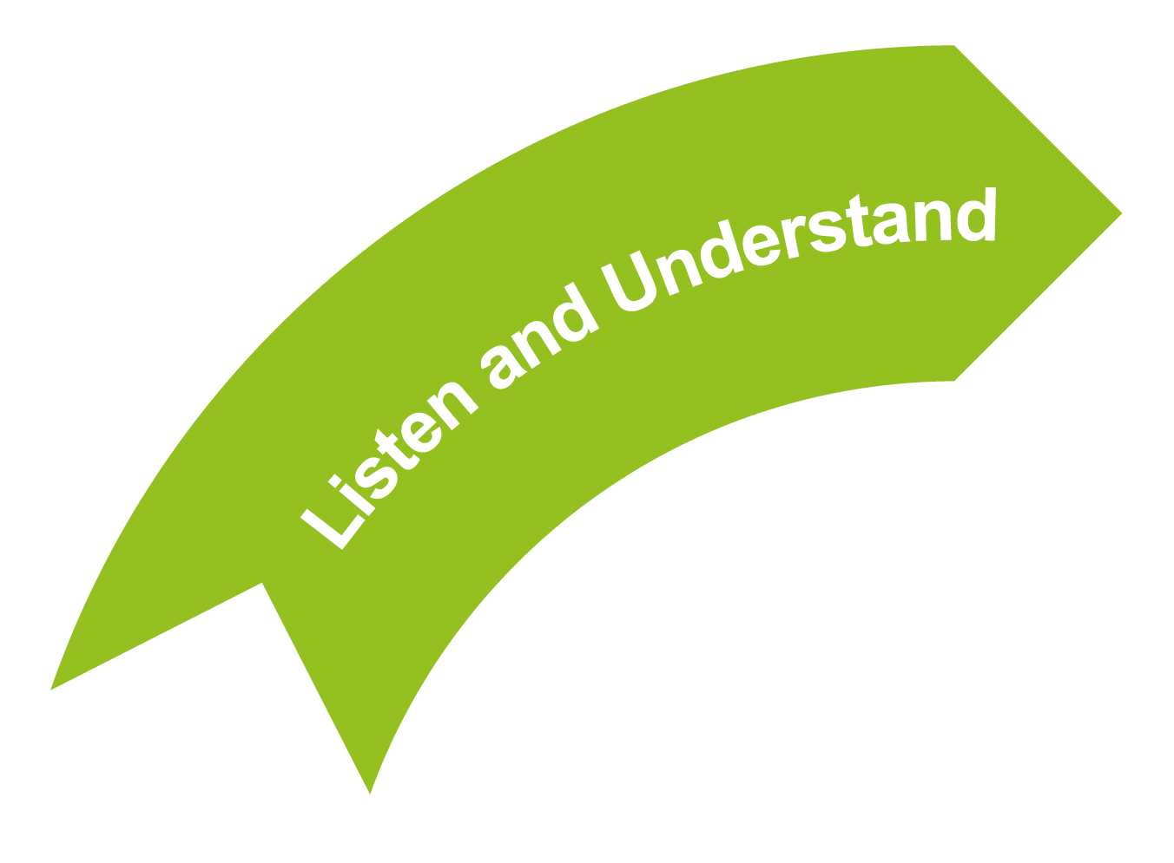

Slide 9
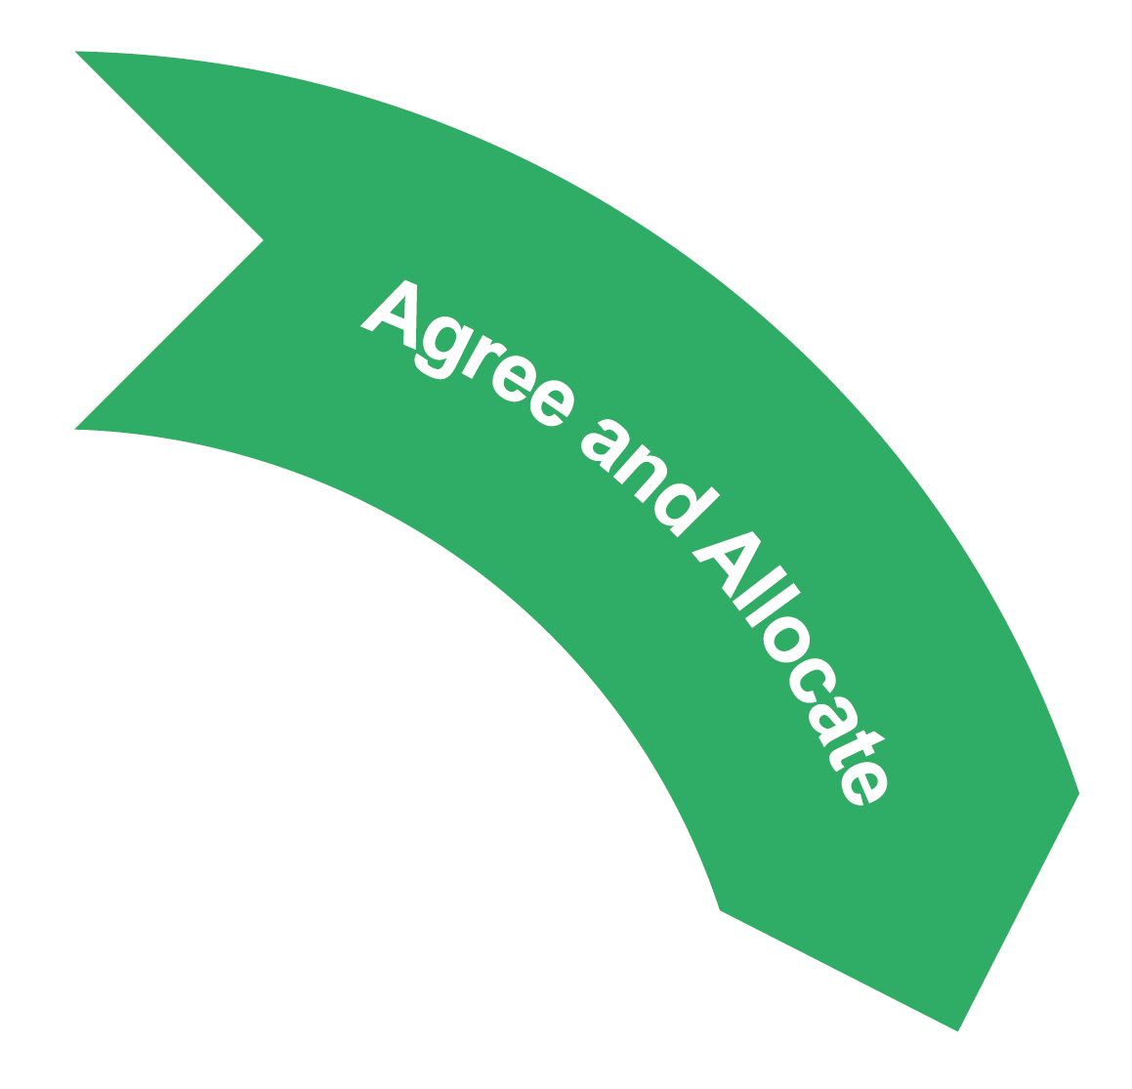

Slide 10


Slide 11


Slide 12


Slide 13

Mechanics
Approach
Values
Heather Simmons – used with permission

