Slide 1




Integrating the workforce, funding and good practice
Good practice webinar – In Control members
Friday 4th December 2015

Slide 2
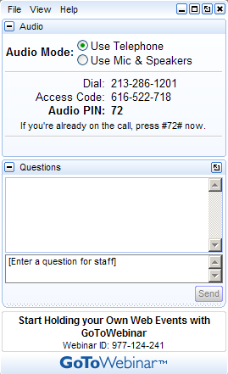
how the webinar works
You will see a toolbar like this on the right hand side of your screen
Questions can be typed in to the ‘enter question here’ box

Slide 3
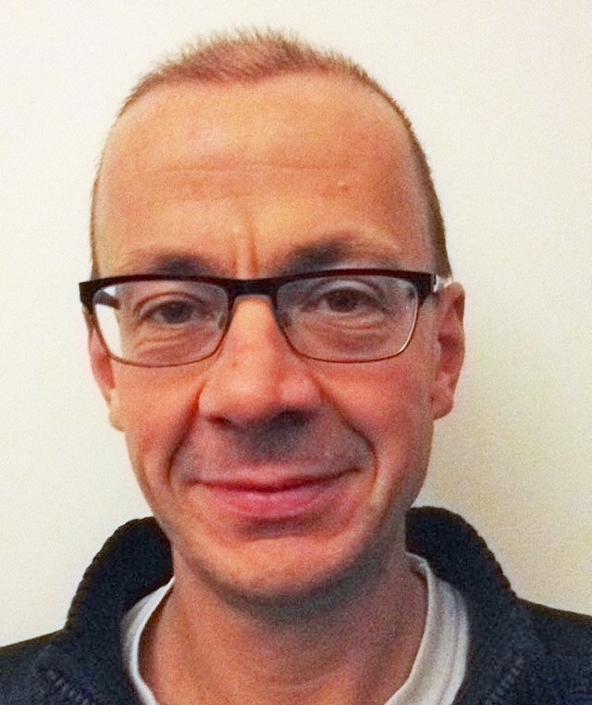
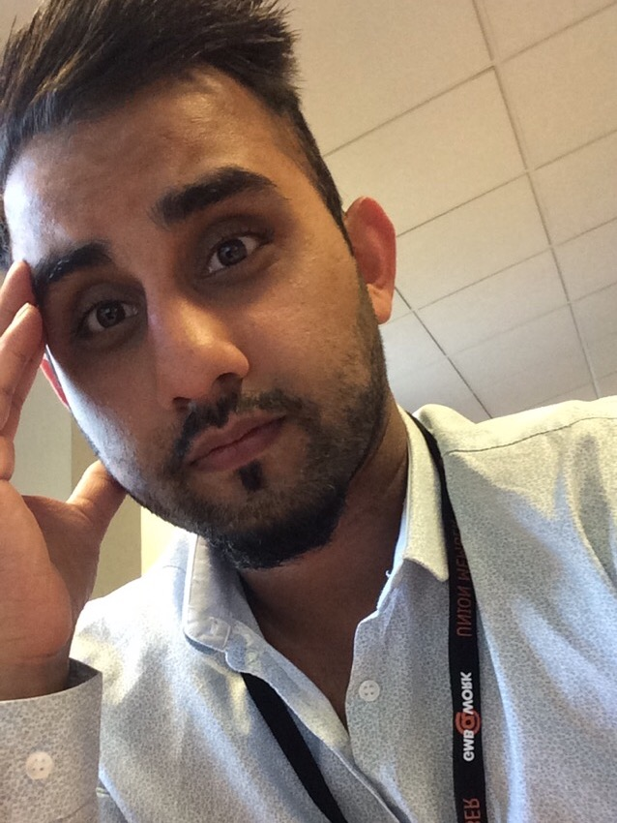
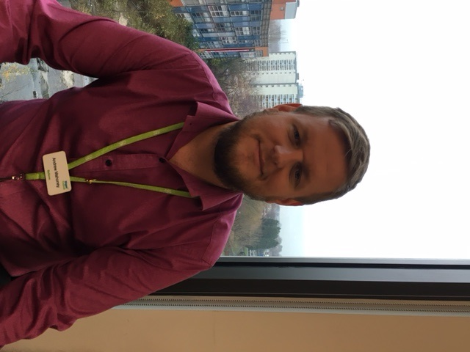
Introducing…
Andy Mahoney,
Wigan MBC
Andrew Baxter
In Control
Aamar Mahmood
Bradford MDC

Slide 4
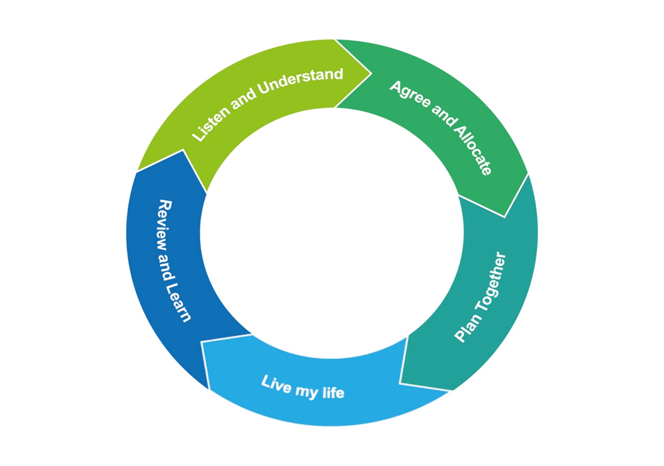

Building a Community of Change
Collecting and sharing good practice

Slide 5
Bradford
Special educational needs and disability code of practice:
0 to 25 years

Slide 6
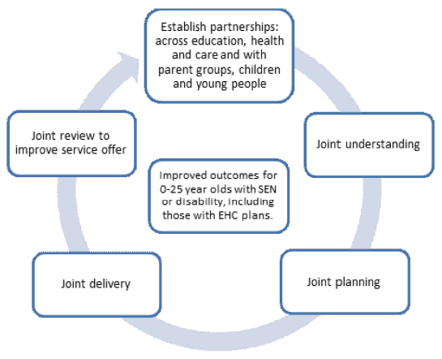
Chapter 3 – Working together across Education, Health and Care for joint outcomes
Local authorities and their partner commissioning bodies have a duty for developing joint arrangements for commissioning services to improve outcomes for 0 to 25-year-old children and young people who have special educational needs (SEN) or disabilities, Including those with Education Health and Care (EHC) plans.
The Joint Commissioning Cycle

Slide 7
How Bradford adopted the Code of Practice
Children’s Complex Health or Disabilities Team – Children’s Social Care
Children’s Continuing Health Care – NHS
Children’s Services SEN Team - Education
The Transitions Team – Adult’s Social Care
Occupational Therapist Team – Hot desk
Located at
Margaret McMillan Towers
Floor 5
Princes Way
Bradford
BD1 1NN
01274 435750

Slide 8
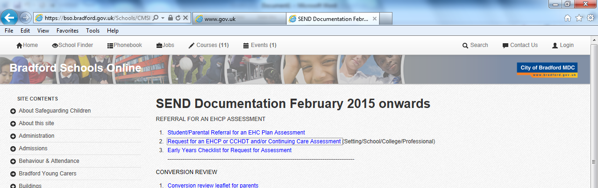
Referral
Parents / Carers can make a direct referral over the telephone or online for special educational needs and disability specialist assessment and support service.
Professionals to complete the referral form online and to send back gaining consent from parents / carers for all 3 areas to be discussed (Ed, Health and Social Care)

Slide 9
Screening
Takes place every afternoon with a member of each key team
Children’s Services SEN Team,
Children’s Continuing Health Care,
Children’s Complex Health or Disabilities Team – Children’s Social Care
If available info is on the system or if the child has been previously known then the key info will be shared across all teams. Everyone has a copy of the referral and decisions are made jointly in regards to who is going to assess, and for what?
Weekly Joint Assessment Panel – quality assures the screening

Slide 10
What happens next
Children’s Complex Health or Disabilities Team – Children’s Social Care
- Allocation ASAP (usually within 1 working day)
- Single Assessment completed and authorised by a Social Care Team Manager within 9 weeks
- SW to attend Referral Panel for Services and update care plan within 4 weeks
- If joint package with partner agencies then Joint Resource Panel will be informed

Slide 11
Preparation to Adulthood
Children’s Social Care would make a referral to The Transitions Team – Adult’s Social Care at 16 years old.
At 17 years old, Adult’s Social Care would allocate a worker and start the assessment process with the aim of having services in place on the child’s 18th Birthday when Children’s Social Care would cease their involvement.
Next Steps: Plans for a 14-25 team which will be lead by the adults transitions team. Main focus will be to join up with Children’s from an earlier age and start the preparation to adulthood outcomes. Health Transitions Practitioners to join up too.

Slide 12



An Integrated Approach
To Implementing the SEND
Reforms
Andy Mahoney – Lead for SEND and Personalisation

Slide 13
Where we started!!!
SEND Pathfinder Area
Jointly funded posts – across CCG and LA
Built on strong links with Education/Schools
Parental engagement
Dedicated team to help implementation – including rep’s from LA, Schools and CCG.
Things have constantly changed and new barriers arrive every day – have to adapt, try new things.

Slide 14
What have we achieved so far?
Integrated EHC pathway (Outcome focused) Includes an integrated assessment and Person centred planning single EHC planning process.
  Integrated Personal Budgets policy
  Integrated Key Working team
Partnership working – Joint approaches across education, health and social care
  Integrated Commissioning structure – EHC/CC Panel
  Shared vision and strategy
  Aligned Funding streams
  Involved Children and Young People with SEN and disabilities and their families – ‘co production’.

Slide 15




How far we have progressed…
421 EHC PLANS (Statutory and non statutory) inc transfers – January 15
18 Personal Budgets (3 funded through health funding), plus those through testing PHB’s

Slide 16

What changed/slowed progress?
We could only influence so much operationally, without a buy in from strategic leads across our partners.
Delivering on the transfers of plans – takes time, slows development.
Organisational change!
Notes:
Organisational change (The Deal helped overall, but had to wait for things to catch up)

Slide 17

What steps did we take?
Accountability from the Wigan Health and Well Being board and Children's Trust (legal requirement).
Use strategic relationships to break down the barriers.
Use inspection as catalyst for engagement.

Slide 18
The Deal for the Future - 2020
Key principles of future reform in Wigan, including closer alignment of commissioning arrangements, establishment of new integrated provision model, and core and collective ambition around population health, prevention and early implementation. (Locality Plan)
An asset-based approach that recognises and builds on the strengths of individuals, families and our communities.
Integrated services that place families and communities at the heart of everything.

Slide 19
Locality Plan & GM Devolution
Partners in Wigan Borough will secure the greatest and fastest possible improvement to the health and well-being of our population.
We believe that Greater Manchester Devolution offers us a unique opportunity to move further and faster on our local transformational programme of work.
We recognise that to drive a transformation programme at this scale will require greater alignment both between CCG and Council in respect of commissioning and between provider organisations.
Offers an ‘joint working’ infrastructure to support the delivery of the SEND reforms in Wigan. Solid platform to break down barriers.

Slide 20
Headlines – moving forward
Communities Investment Fund
Start Well New Delivery Model – Schools
A Perfect Week – March 2016 in Hope School
SEND reform Partnership Group – local area strategy
Monitor & Evaluation to Improve & Develop
Back to Block Contracts and develop Personal Budgets (Long term conditions)
Remain on target for EHC transfers by 2018.

Slide 21

questions and discussion

Slide 22
Coming Soon…
West Berkshire: A single common sense ‘front door’ for direct payments that:
Has evolved in partnership with parents over two years;
Can make payments from education, health and social into a single bank account;
One set of returns and monitoring for families;
Now supports over 100 families including some with payments with multiple funding streams.

Slide 23
Integrating the workforce, funding and good practice
Good practice webinar – In Control members
Friday 4th December 2015
andrew.baxter@in-control.org.uk

