Slide 1
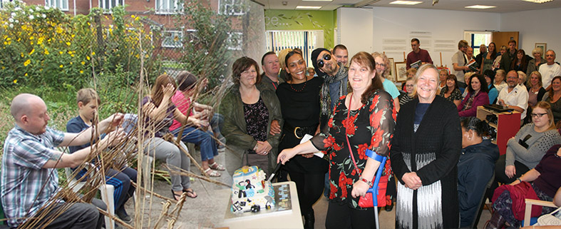
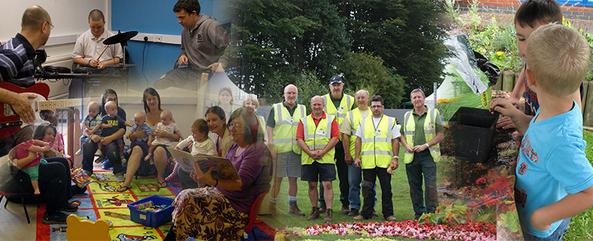

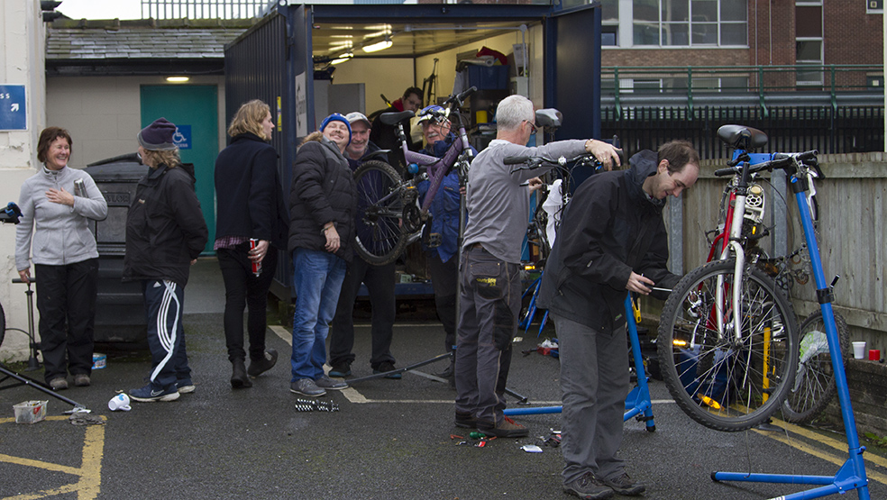
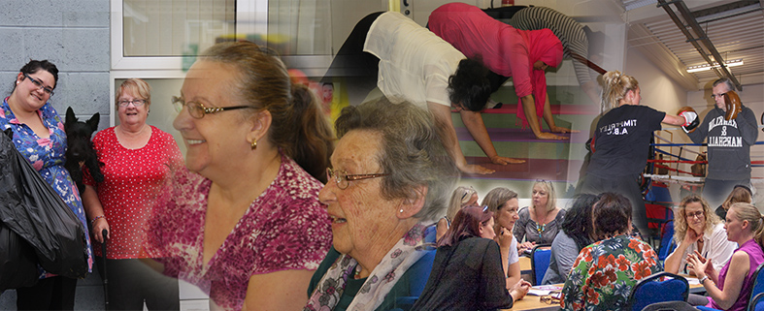
blueSCI Mental Health and Wellbeing Service
Alicia Clare & Stuart Webster

Slide 2
Introduction
Mental Health and wellbeing commissioned service
Delived through facilitating 4 community venues.
Two of which are embedded within library services.
Over 100 volunteers
Over 50 community groups and partners
Grant distribution programme

Slide 3
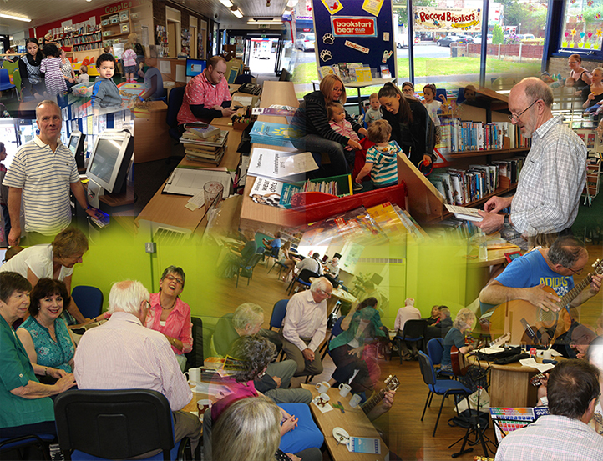

Slide 4
What blueSCI facilitates
Wellbeing Hubs run by & for local residents
Creative Arts & Cultural Opportunities
Psychological Interventions in a social setting
Range of courses, skills sharing, social enterprise
Volunteer training opportunities
Learning Environment with high quality arts and sports facilities
2 Community cafes

Slide 6
The Model of Transformational Change
Adapt
Respond
Raised
expectations
Seeing things
differently
Embed
Holistic
approach
Enviro-
culture
Eudaimonic
wellbeing
Emergence
Access as a catalyst
Transformation
Flow
Engagement
Learning
Relationships
Personal
development
Sustainability
Practitioner
Cycle
Partnerships
Structure
Participant
Cycle
Kilroy A.J. (2007)

Slide 7
How to Contact Us
www.bluesci.org.uk
enquiries@bluesci.org.uk

