Slide 1
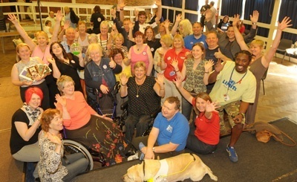
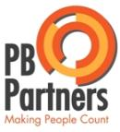
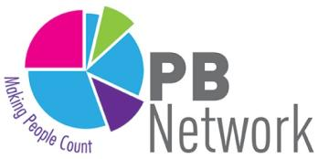

Participatory Budgeting
Builds mental capital
Jez Hall Shared Future CIC

Slide 2
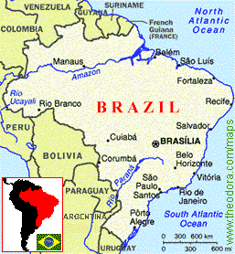
P
A
R
T
I
C
I
P
A
T
I
O
N
Around the world...
ORIGINS OF
PARTICIPATORY BUDGETING
Began in Porto Alegre, Brazil in 1980s – city of more than 1.5m people
End of military dictatorship and election of Workers’ Party
Public coffers were dry, needs pressing and democracy needed to be done differently
= innovation!

Slide 3
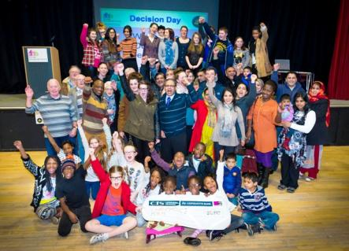
P
A
R
T
I
C
I
P
A
T
I
O
N
What is Participatory Budgeting?
Local people (we call them citizens) making Direct Decisions over how to spend some of your public money... But not all!
Supported by experts and politicians
Empowering, not manipulating.
Asset based approach to co-production
Think of it a personalised budget... For a whole community!
Community led commissioning FOR REAL:
Real money, real decisions, real responsibility.
‘If it feels like we have decided ---- it’s PB.
If it feels like someone else has decided, it isn’t.’
Brazilian resident involved in PB

Slide 4
The Empowerment Line
PB works in different ways, but should be meaningful and change how money is spent
P
A
R
T
I
C
I
P
A
T
I
O
N
Consulting
Partnership
Decision making
Communicating
Involving
Scope of PB activity
Passive engagement (not PB?) Empowerment through PB
Progression

Slide 5
P
A
R
T
I
C
I
P
A
T
I
O
N
Yr 1
Evaluation and Learning
Design
Yr 2
Scrutiny and Monitoring
PB budget cycle
=
participatory activity at all stages
Informing and engaging
Yr 3
Yr 4
Delivery of new projects
Setting
of
Priorities
Decision Making
Develop budget
Ideas

Slide 6


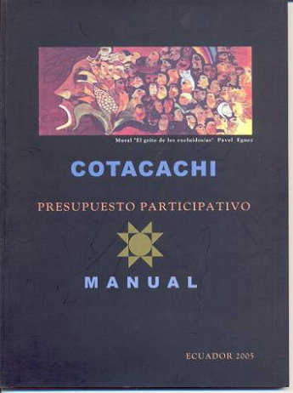

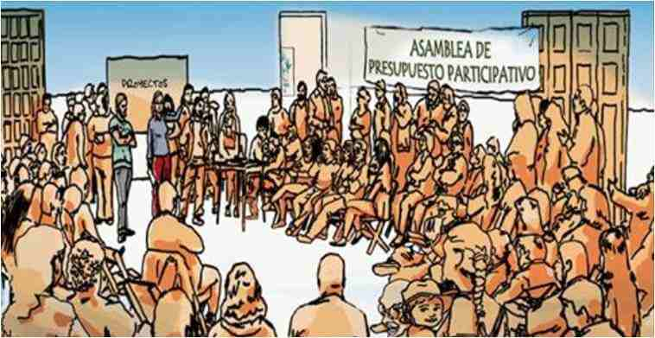
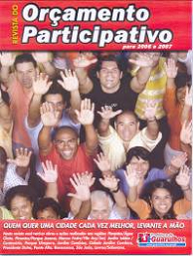
P
A
R
T
I
C
I
P
A
T
I
O
N
Around the world...
ORIGINS OF
PARTICIPATORY BUDGETING
Spread across world…
e.g. Recife
Winner of Reinhart Mons Democracy Prize in 2011
Offline and Online participation that reached hundreds of 100,000s of the population.
Over 3000 recorded PB experiences worldwide

Slide 7
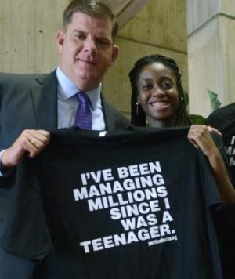
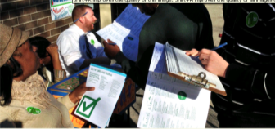
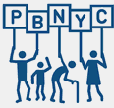


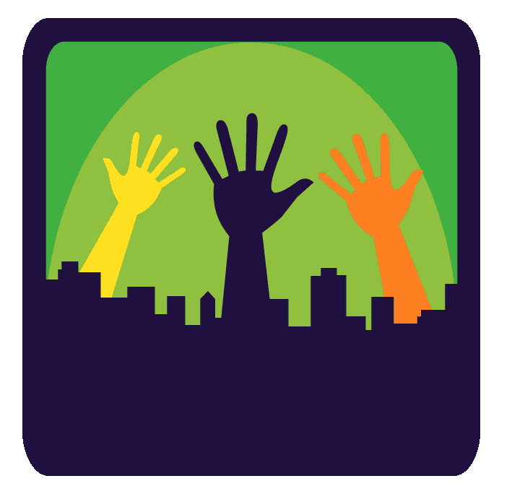
P
A
R
T
I
C
I
P
A
T
I
O
N
Around the world...
USA and Canada
Chicago was first major programme $1m... Now $6m
New York growing from $4m ................. to $32m per year
Vallejo: A Californian success story built on hard times
City of Boston: 3rd consecutive year of $1m of PB capital funds
branded as Youth Lead the Change:

Slide 8
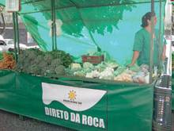

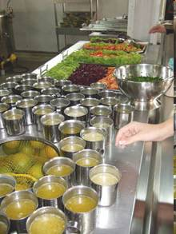
P
A
R
T
I
C
I
P
A
T
I
O
N
Around the world...
BELO HORIZONTE, BRAZIL
The city that ended hunger
“To search for solutions to
hunger means to act
within the principle that ….
the status of a citizen
surpasses that of
a mere consumer.”

Slide 9
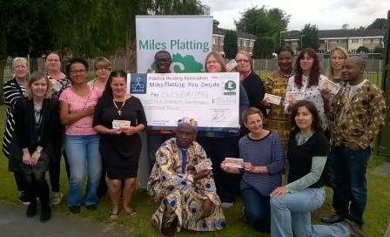
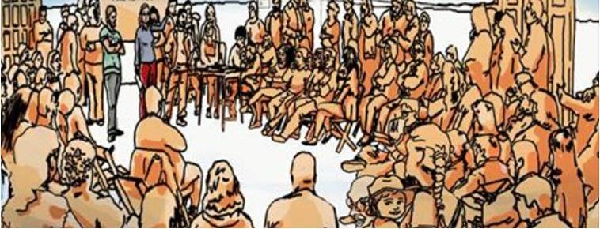
Two basic models in the UK
P
A
R
T
I
C
I
P
A
T
I
O
N
Participatory Grant making
Local people deciding on
local funding
Community Led Commissioning
aka Community Budgets

Slide 10
What I believe
P
A
R
T
I
C
I
P
A
T
I
O
N
Encourages volunteering
Shows there is ‘a healthy community’
Increases ‘happiness’ with democracy
Breeds mutual respect and understanding
A sense of belonging and ‘social capital’
Leads to stronger partnership working
Drives resources to the grassroots

Slide 11
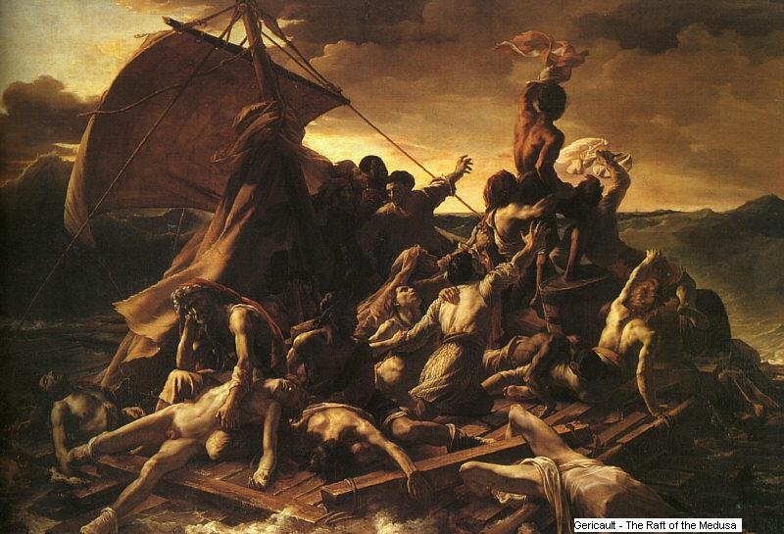
TRENDS
The graph of doom - Austerity

Slide 12

TRENDS
A carbonised economy

Slide 13
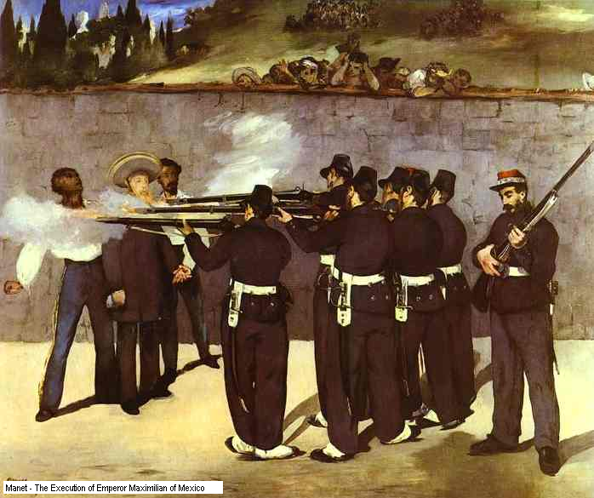
TRENDS
The democratic deficit

Slide 14


TRENDS
Atomisation and communities of interest

Slide 15
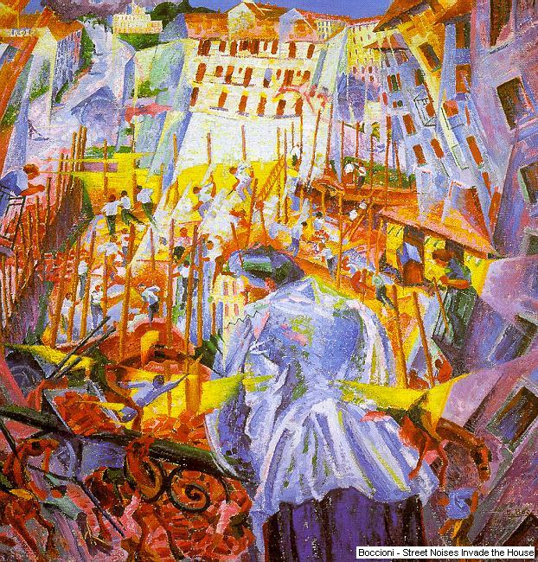
OPPORTUNI TY
Participation alongside Representation

Slide 16
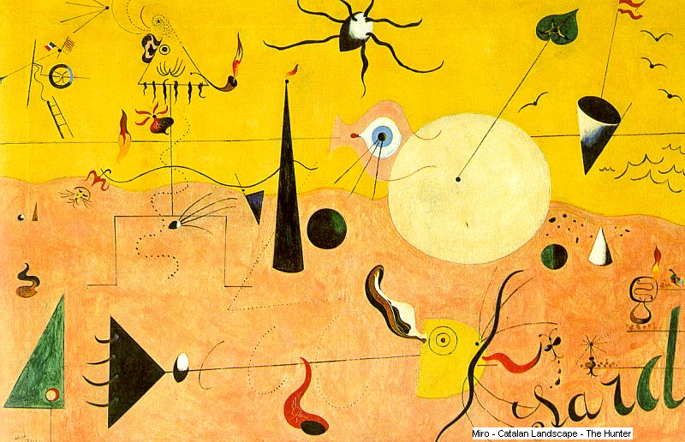
OPPORTUNI TY
Connected communities and infectious ideas

Slide 17
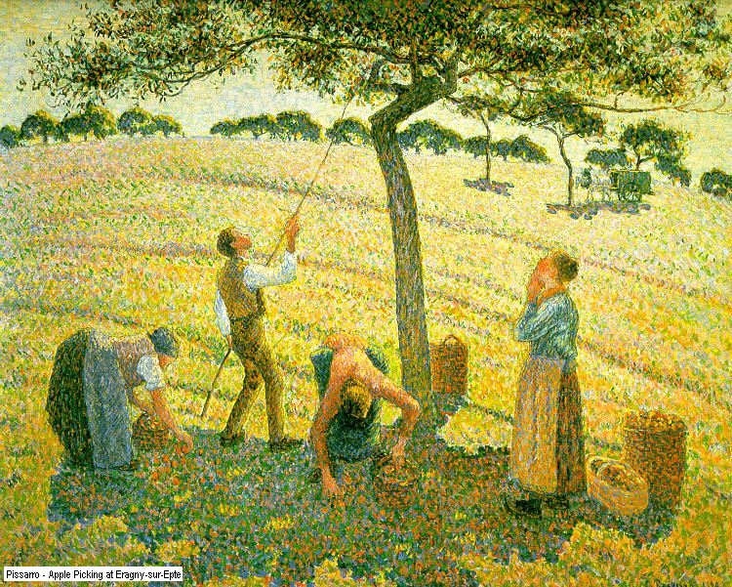
OPPORTUNI TY
Co-operation and volunteering

Slide 18
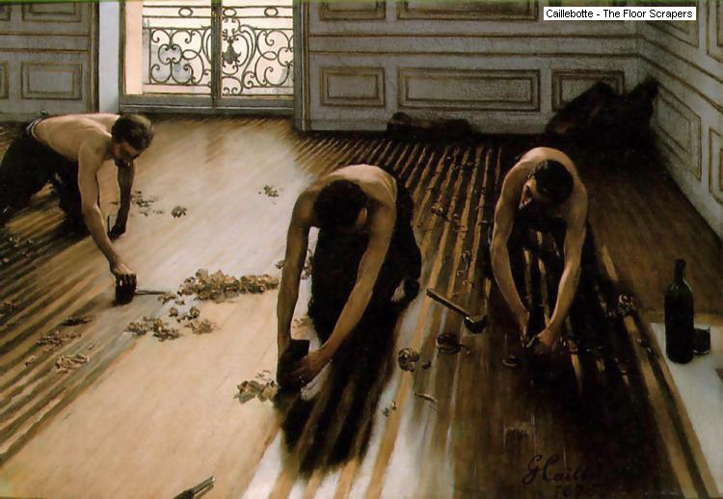
LEVERS
Human nature is good – work with that grain

Slide 19
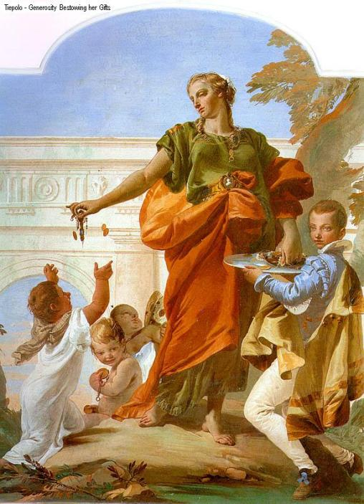
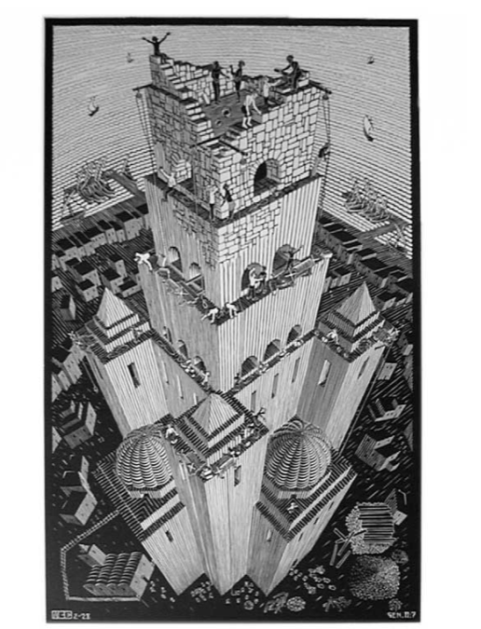
LEVERS
Models of devolved leadership and co-production

Slide 20
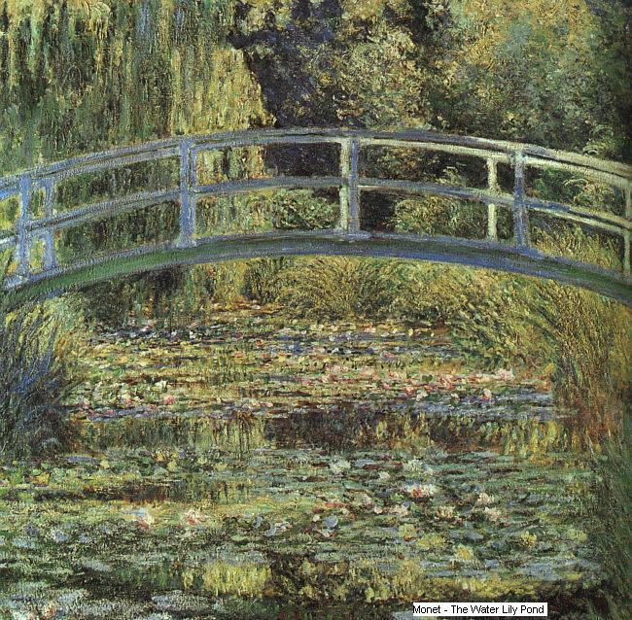
LEVERS
Boundary Spanning and Social Capital

Slide 21
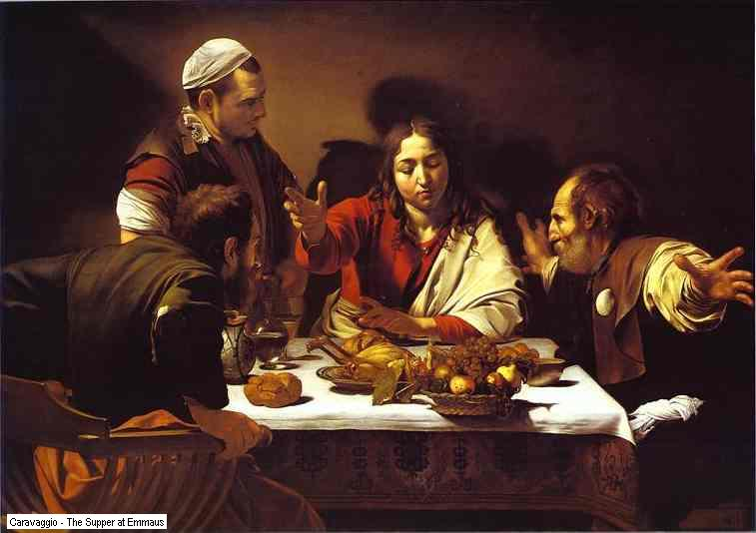
LEVERS
Deliberative Spaces – On and Offline

Slide 22

P L A
Y
YOUR
P
AR
T
Modelling Good Behaviour

Slide 23
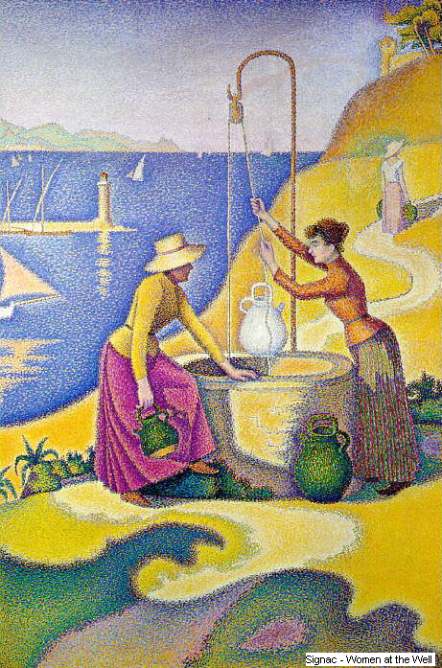
P L A
Y
YOUR
P
AR
T
Forging relationships
Forming wellbeing
Building social capital

Slide 24
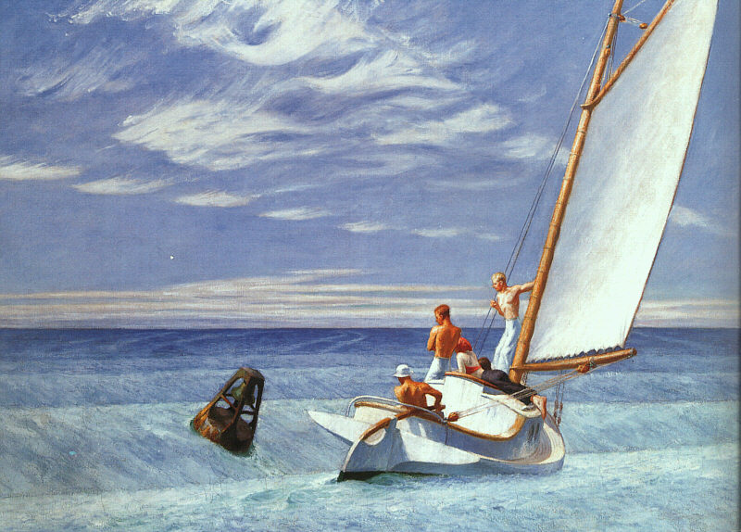
P L A
Y
YOUR
P
AR
T
Combining Experiences and Energies

Slide 25
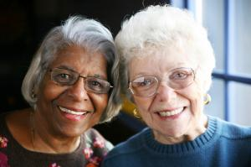


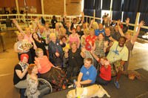
M
E
N
T
A
L
C
A
P
I
T
A
L
Health related PB... Not just me then...
Over-50s vote on Connect Hackney Aging Better £1.5m funded by the lottery (2015 ongoing)
Well London uses Participatory Budgeting to improve health and wellbeing (2012-15 ongoing)
Due North Health Equity report recommends
more participatory budgeting (2014)
Health in your hands: using PB to tackle lung disease in Leicester (2013)
Richmond Fellowship Scotland:
Outcomes are fun, (2013)
Your Community, Your Health, Your Voice
in Southampton (2006 onwards)
“I feel like I am somebody”

Slide 26
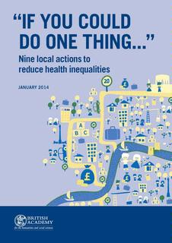
M
E
N
T
A
L
C
A
P
I
T
A
L
Mental Capital and PB
In British Academy report on reducing health inequality
“If you could do one thing”
Professor Kwame McKenzie, respected Canadian
expert on mental health, proposes
"Using PB to Improve Mental Capital
at the Local Level".
“I have no doubt that there will be locally chosen and appropriate initiatives that promote mental capital. But participatory budgeting, if done correctly, has the potential to leverage those for even greater benefit, as well as developing resilient and socially cohesive populations.”
And ..... across time in different municipalities I find a robust pattern linking the use of participatory budgeting to a change in the pattern of government expenditures ... adopting municipalities tend to increase the spending on health and sanitation significantly more than their non-participatory counterparts.
The Effects of Participatory Budgeting on Municipal Expenditures and Infant Mortality in Brazil,
by Sonia Goncalves, King’s College London, UK.

Slide 27
Talk to me
S
H
A
R
E
D
F
U
T
U
R
E
W: www.sharedfuturecic.org.uk
E: jez.hall@sharedfuturecic.org.uk
T: 07963 706106

