Slide 1
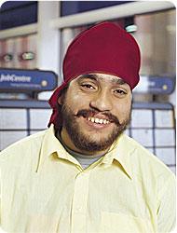
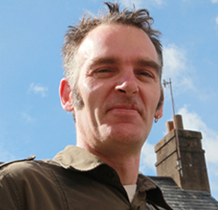
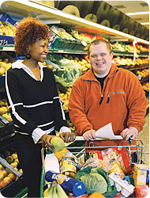


My Time, My Community – volunteering and citizenship
Andrew Tyson

Slide 2
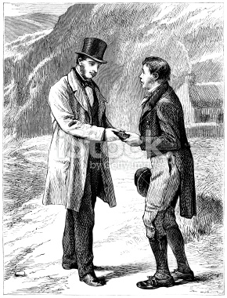
Getting to know each other
one recent experience of volunteering or contribution or neighbourliness in my life …

Slide 3
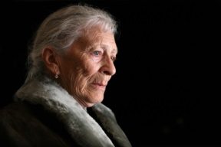
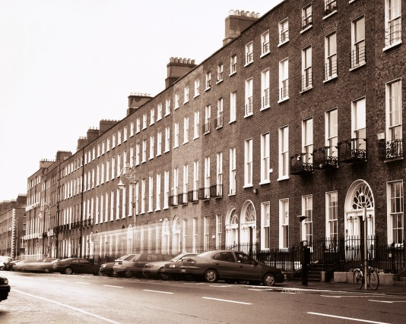

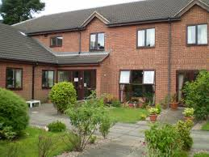

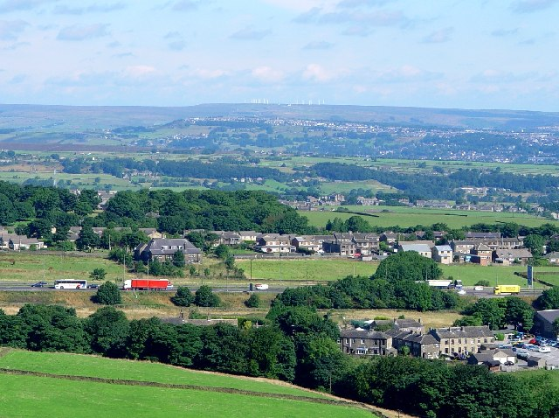

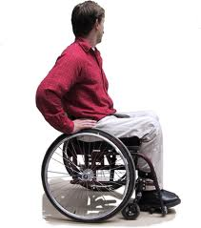
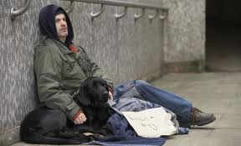
Diverse citizens, diverse communities

Slide 4
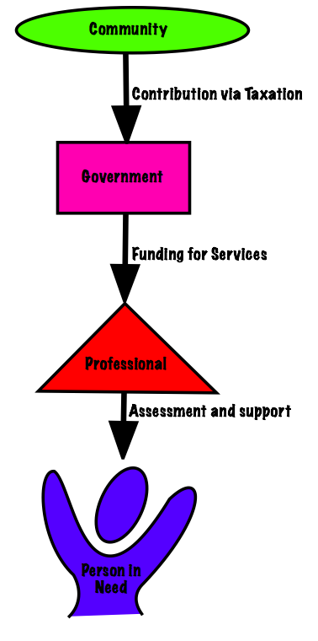
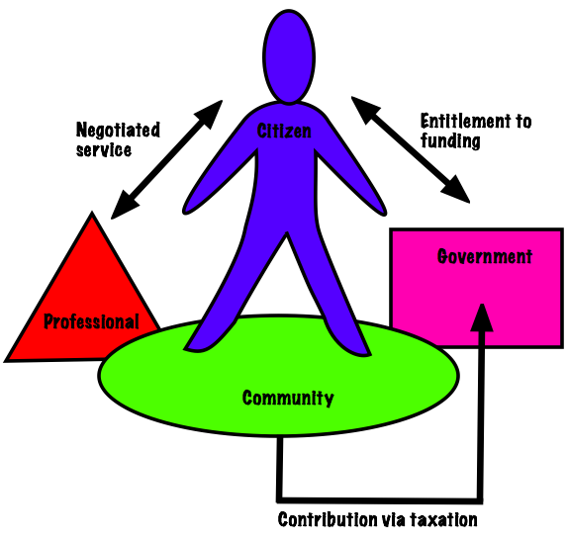
From the gift of welfare to active citizenship

Slide 5
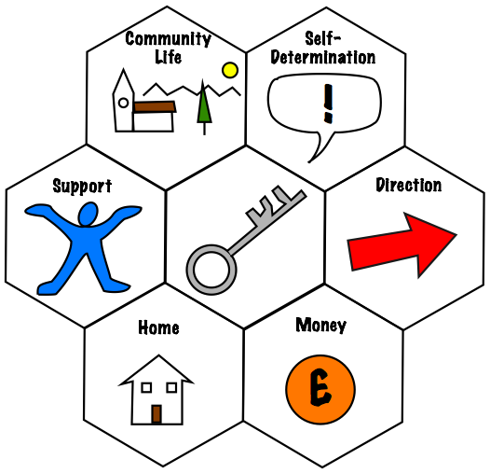
Citizenship
“Citizenship is being someone who has respect within the community and who acts to support and sustain that community. Our commitment to each other and to the public services which support is relies on the willingness of citizens to contribute practically and financially to the strengthening of these services. If we erode citizenship, make participation and contribution harder then we will eliminate the very fabric of the community itself. Citizenship promised better outcomes by strengthening the commitment of each of us to each other and to the whole community”. (Simon Duffy)

Slide 6
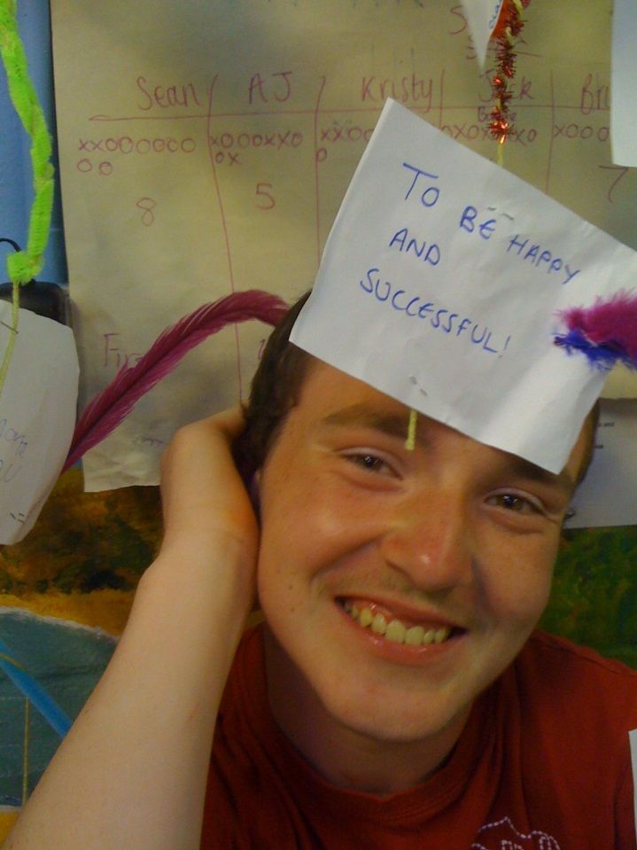
A contribution by all…

Slide 7
Questions for today
What do mean by contribution?
How can we encourage more people to make a contribution in their own way…
…and to feel good about it?
And can we/should we tie these varied contributions into formal systems of care and support?

Slide 8


Slide 9
Volunteers in health and care
King’s Fund, 2013
3 million volunteers in health and care in England
“…play an important role in improving people’s experience of care, building stronger relationships between services and communities, supporting integrated care, improving public health and reducing health inequalities. The support that volunteers provide can be of particular value to those who rely most heavily on services, such as people with multiple long-term conditions or mental health problems.”
“There are huge opportunities for volunteering to help transform health and social care services and bring about real improvements for patients and the wider public. The challenge now is to ensure that the system can make the most of these opportunities. Many organisations lack a strategic vision for the role of volunteering within their workforce, and so miss the opportunities that exist.”

Slide 10
Policy context
NHSE Five Year Forward View
The Care Act
Disability and Health Employment Strategy
Children and Families Act

Slide 11
Volunteering: what does research show?
Volunteering:
improves health and wellbeing
supports person-centred integration
helps people develop skills
helps to cultivate employment aspirations people did not previously have

Slide 12
But…
Disabled people continue to report barriers:
47% of 100,000 disabled people said that their services did not enable them to participate in community life, including volunteering, due to lack of support (“The Other Care Crisis” Leonard Cheshire Disability et al, 2013)
25% of disabled people aged 16-34 felt that attitudinal barriers (confidence) stopped them from participating in community activities (Office for Disability Issues, 2008)
19% stated that transport and access to venues were barriers to participation (Office for Disability Issues, 2008)

Slide 13
Some key questions
How do we:
Increase access to volunteering by disabled and excluded people?
Improve support systems?
Develop roles of real interest and value?
Ensure that all of this is person centred?

Slide 14
Contribution through volunteering
Disabled people participating as active and equal citizens
in their local communities: as volunteers, neighbours and
family members with civic and social responsibilities.
Training
Supported and
Independent
Volunteering
Social Inclusion
Supported
Employment

Slide 15

The CTV Triangle
Beneficiary (V)
Support mentor (V)
Volunteer Support worker (P)

Slide 16
Support for me to make a contribution
“Help to think through what I am good at, how I can help… a plan?”
“Guidance on how to find out where I can help.”
“Support, mentoring, confidence to make this real and keep going with it.”

Slide 17
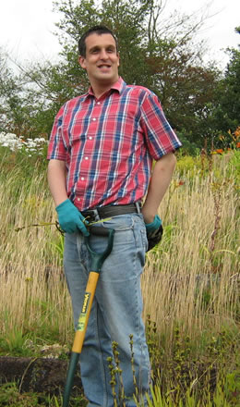
Supported Volunteering
Steven (beneficiary) – “I feel a sense of achievement in doing something to contribute…CSV have taught me to catch the bus…they are teaching me at the moment how to help in a shop, from cleaning, rotating stock, and also serving customers.”
Chrissie (parent carer) – It (CSV) is exactly what he needs, it is a shame he couldn’t have received this kind of support years ago”.
Jenny (support mentor) - “I really enjoyed meeting the people I support and feel in a small way I can make a difference”
Shirley (beneficiary) - “I have made friends among the group and gained confidence interacting with people.”

Slide 18
Volunteering Matters
Leading UK volunteering in policy and practice for 52 years
A vision of a society where everyone can participate in order to build strong and inclusive communities
Mission: by investing in people through volunteering we can reduce inequalities and isolation to build those stronger, more inclusive communities

Slide 19
Volunteering Matters programmes
Volunteering and the Care Act, with LGA
Volunteering and quality, with CQC and providers
Volunteering and impact, with Public Health England and Hampshire CC
Retired and Senior Volunteers Programme
Full time volunteers programme

Slide 20
The Quality programme: Emerging issues/what people have told us
The Care Act: wellbeing, prevention, integration…
Not about job substitution
Some good practice exists today…but it’s not the norm
We need to test our draft guidance in diverse settings and situations…care homes, people’s own homes
Think about the full range of volunteers and volunteering arrangements
Think more about volunteering around the person…matching people
Think more about people who use services as volunteers, what do they want and need?

Slide 21
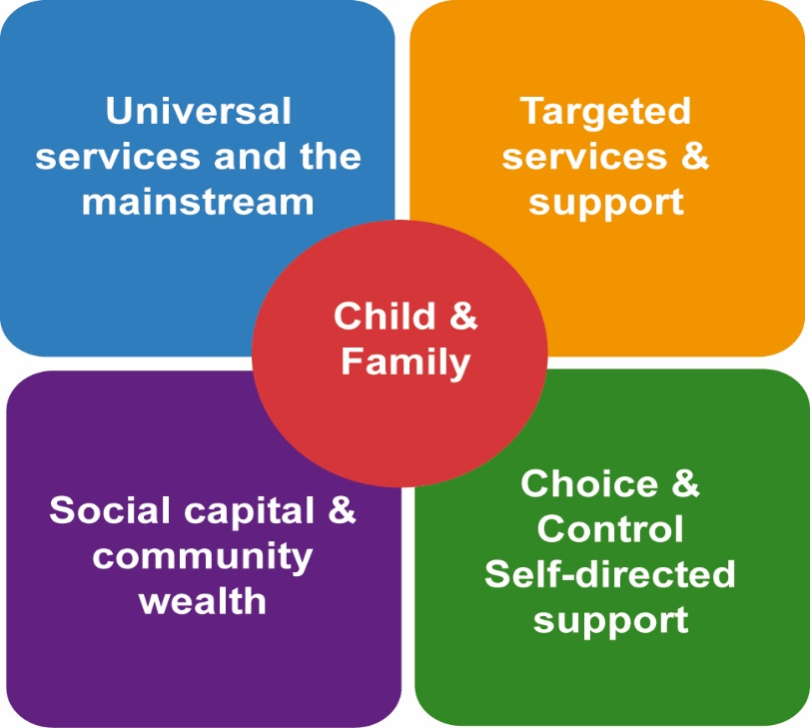

Moving From right to left…
People
Notes:
Familiar. Direction of travel also now familiar. But how?

Slide 22
Some key questions
Where are the major opportunities?
How can those people with personal budgets use them to be a volunteer?
What about people who don’t have a personal budget?
Are there other ways of getting funding?
And what about personal health budgets?
Rural-urban issues? Transport issues?
Cultural issues?
Issues of safety, risk and risk management?

Slide 23





Beware co-opting volunteers
Care Act 2014

Slide 24
Back to the questions for today
What do mean by contribution?
How can we encourage more people to make a contribution in their own way…
…and to feel good about it?
And can we/should we tie these varied contributions into formal systems of care and support?

Slide 25

Observations?
andrew.tyson@in-control.org.uk

