Slide 1
The wellbeing principle
Local authorities must promote wellbeing when carrying out any of their care and support functions in respect of a person.
The wellbeing principle applies in all cases where a local authority is carrying out a care and support function, or making a decision, in relation to a person.

Slide 2
From service eligibility to meeting needs
The Act signifies a shift from existing duties on local authorities to provide particular services, to the concept of ‘meeting needs’ (set out in sections 8 and 18-20 of the Act).
This is the core legal entitlement for adults to care and support, establishing one clear and consistent set of duties and power for all people who need care and support.

Slide 3
The dimensions of the wellbeing principle
Personal dignity (including treatment of the individual with respect);
Physical and mental health and emotional wellbeing;
Protection from abuse and neglect;
Control by the individual over day-to- day life (including over care and support provided and the way it is provided);

Slide 4
The dimensions of the wellbeing principle
Participation in work, education, training or recreation;
Social and economic wellbeing;
Domestic, family and personal relationships;
Suitability of living accommodation; the individual’s contribution to society.

Slide 5
Key standards
The importance of beginning with the assumption that the individual is best-placed to judge the individual’s wellbeing.
The individual’s views, wishes, feelings and beliefs.
The importance of preventing or delaying the development of needs for care and support and the importance of reducing needs that already exist.
The need to ensure that decisions are made having regard to all the individual’s circumstances.

Slide 6
Key standards
The importance of the individual participating as fully as possible.
The importance of achieving a balance between the individual’s wellbeing and that of any friends or relatives who are involved in caring for the individual.
The need to protect people from abuse and neglect.
The need to ensure that any restriction on the individual’s rights or freedom of action that is involved in the exercise of the function is kept to the minimum necessary for achieving the purpose for which the function is being exercised.

Slide 7
The Care Act and whole life approach
Act requires whole system, whole council, whole-family approach to coordinate care and support around the person and their family and considering the care needs of an adult on their family, including children.
Statutory Guidance says:
  “The intention of the whole-family approach is for local authorities to take a holistic view of the person’s needs and to identify how the adult’s needs for care and support impact on family members and others in their support network.”

Slide 8
Whole life also means…
“Prevention”
A strengths based approach
Good transition
….one system, one life, whole life

Slide 9
“Prevention”
2.1 It is critical to the vision in the Care Act that the care and support system works to actively promote wellbeing and independence, and does not just wait to respond when people reach a crisis point. To meet the challenges of the future, it will be vital that the care and support system intervenes early to support individuals, helps people retain or regain their skills and confidence, and prevents need or delays deterioration wherever possible.

Slide 10
“Prevention”
2.3. The local authority’s responsibilities for prevention apply to all adults, including:
• people who do not have any current needs for care and support;
• adults with needs for care and support, whether their needs are eligible and/or met by the local authority or not;
• carers, including those who may be about to take on a caring role or who do not currently have any needs for support, and those with needs for support which may not be being met by the local authority or other organisation.

Slide 11
Strengths
6.63. At the same time as carrying out the assessment, the local authority must consider what else other than the provision of care and support might assist the person in meeting the outcomes they want to achieve. In considering what else might help, authorities should consider the person’s own strengths and capabilities, and what support might be available from their wider support network or within the community to help. Strengths-based approaches might include co-production of services with people who are receiving care and support to foster mutual support networks.

Slide 12
Good transition
16.1. Effective person-centred transition planning is essential to help young people and their families prepare for adulthood. Transition to adult care and support comes at a time when a lot of change can take place in a young person’s life. It can also mean changes to the care and support they receive from education, health and care services, or involvement with new agencies such as those who provide support for housing, employment or further education and training.

Slide 13
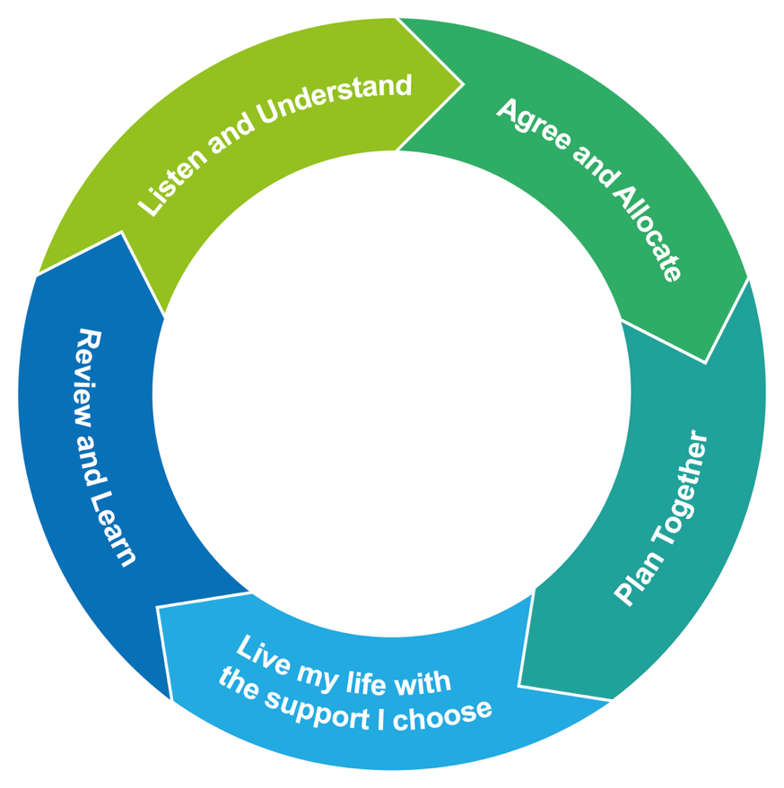
One system, one life, whole life

